Slide 1

Kidney Stone Detection using CNN
Dinesh Arasavalli (hm3731)

Slide 2
Introduction
Impact of Kidney Stones on Health: Kidney stones are a common health problem that millions of people experience globally. In order to avoid complications and enhance patient outcomes, early detection is essential.​
This project's goal is to identify kidney stones using deep learning and image processing, specifically convolutional neural networks (CNNs) with and without transfer learning, and evaluate the effective method.
Objectives:
To acquire and preprocess a comprehensive dataset of CT scan images for kidney stone detection.​
Implement advanced image processing techniques to enhance image quality and facilitate accurate detection.
​Develop a robust CNN model capable of classifying images with high precision.
​Evaluate the performance of the model using various metrics and validate its effectiveness in a clinical setting with and without transfer learning and evaluate the effective method.

Slide 3
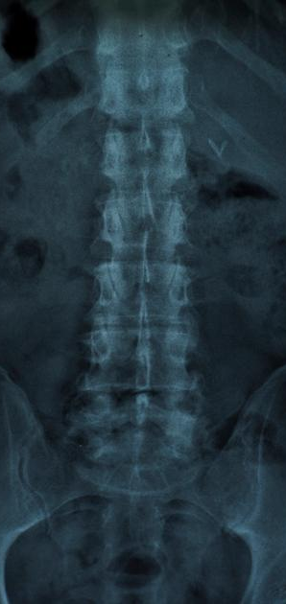
Motivation
Convolutional Neural Networks (CNNs) are used in kidney stone identification with the goal of CT image analysis and minimizing human error in order to improve diagnostic speed and accuracy. This approach not only improves patient outcomes by enabling faster and more accurate treatments but also sets a new standard for technological advancements in medical diagnostics.

Slide 4
Data Processing
The dataset is taken from GitHub, ensuring a diverse collection of CT scan images.
Link to dataset:
https://github.com/yildirimozal/Kidney_stone_detection/tree/main/Dataset​
The images are categorized into two classes: "Kidney_Stone" and "Normal," providing a clear basis for model training and evaluation.
​Standardizing Image Size: To maintain the consistency throughout the dataset, all images are resized to a standard dimension 128 x 128 pixels.
For easier manipulation and processing, each image is transformed into a numpy array along with the corresponding class label.
The dataset is divided into two subsets, with 90% of the data allocated for training and the remaining 10% reserved for testing the model's performance.

Slide 5
Image pre-processing and Segmentation
To enhance the quality of the training images and the learning capacity of the model, several preprocessing steps were applied.
median_blur function is applied to all images to reduce noise, hence clarifying features important for detecting kidney stones, which can otherwise be hidden by image graininess.
Histogram Equilization is a technique that enchances the contrast of the images. Each image is converted to grayscale using the hist function, which also performs gamma correction to improve contrast.
By adjusting image intensities, it enhances the visibility of subtle structures within the images which is crucial for accurate analysis.
The thresholding_img function then applies binary thresholding to highlight important features. ​

Slide 6
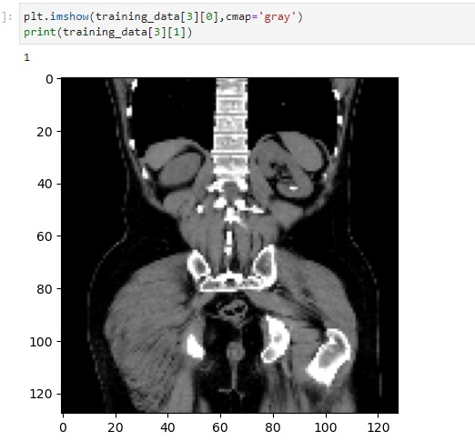
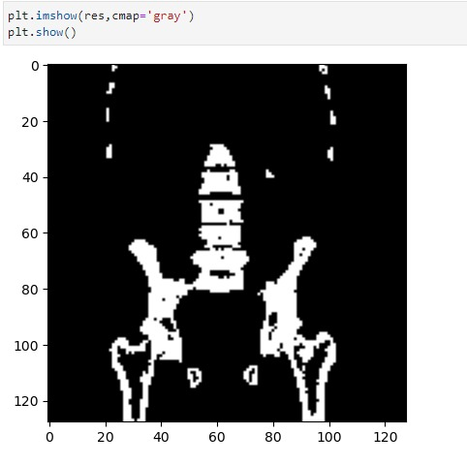
The first image shows the X-ray before preprocessing and the right image shows the CT scan of X-ray after converting to grey scale highlighting the stone area.

Slide 7
Building a CNN model
The model uses a sequential architecture, with two ReLU-activated convolutional layers with max pooling for each to minimize spatial dimensions and control computational efficiency.
The data is converted from 2D to 1D in a flattening step, which makes transition to dense network layers easier.
In order to avoid overfitting during training, it has one dense layer with 80 neurons coupled with a 50% dropout rate.
A dense layer with sigmoid activation produces the final output, which aims to predict the existence of kidney stones as a binary classification.
Accuracy is monitored as a critical performance metric, and the model is constructed using binary cross entropy for the loss function with RMSprop as the optimizer.

Slide 8
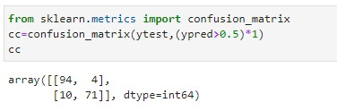
Results
Confusion Matrix: Using the predictions and true labels (ytest), a confusion matrix is generated by the confusion_matrix function from scikit-learn.
Accuracy Score: The model's accuracy is computed by applying a 0.5 threshold to convert the prediction probabilities to binary outcomes and is reported to be approximately 92.18%. This suggests that the test images were successfully classified at a high degree of performance.

Slide 9
CNN with transfer learning
For the transfer learning approach, we leveraged existing pretrained models like CNN(VGG16).
Pre-trained VGG16 as Feature Extractor: The model utilizes VGG16 pre-trained on ImageNet as a fixed feature extractor, with the top layers excluded (include_top=False). The convolutional base of VGG16 processes input images of size 224x224x3. By freezing all layers of the VGG16 model (layer.trainable = False), the model will retain learned features from ImageNet, enhancing its ability to generalize to new datasets without re-learning foundational patterns.
Custom Top Layers for Classification: On top of the VGG16 base, custom layers are added for the specific task of binary classification. These include a Flatten layer to convert 2D feature maps into a 1D vector, followed by a Dense layer with 256 units and ReLU activation for learning non-linear combinations of features. A Dropout layer with a rate of 0.5 is used to reduce overfitting by randomly setting input units to 0 during training, thus helping in generalization.
Model Compilation and Output: The final output layer is a Dense layer with a single unit and a sigmoid activation function, designed for binary output (e.g., classifying images as having or not having a particular feature). The model is compiled with the Adam optimizer and binary cross-entropy loss function, which is suitable for binary classification problems. The model also tracks accuracy as a performance metric during training and evaluation.

Slide 10
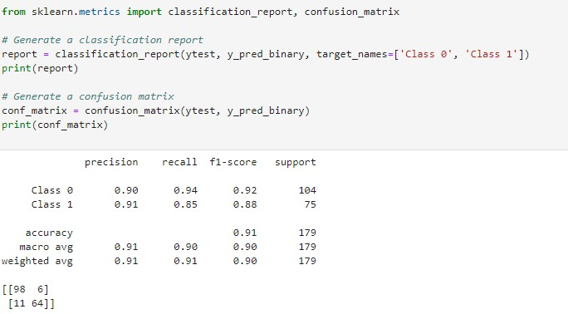
Results
Model Performance: The model achieved a high test accuracy of approximately 90.5%, with a test loss of 0.307, indicating a strong predictive capability on the test dataset.

Slide 11
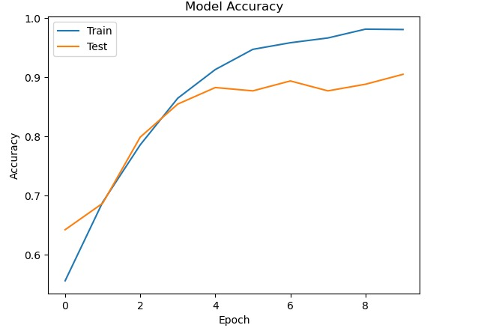
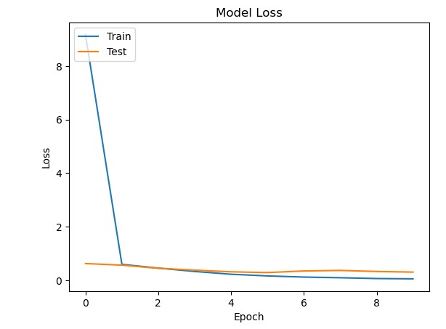
The accuracy graph shows a steady increase in training accuracy over epochs, indicating the model's improving performance on the training set. However, a gap persists between training and validation accuracy, suggesting a potential for overfitting
The loss graph demonstrates a sharp initial decrease in both training and validation loss, followed by a plateau, which indicates the model's quick adaptation and subsequent stabilization. The alignment of training and validation loss trends points towards consistent learning without significant overfitting.

Slide 12
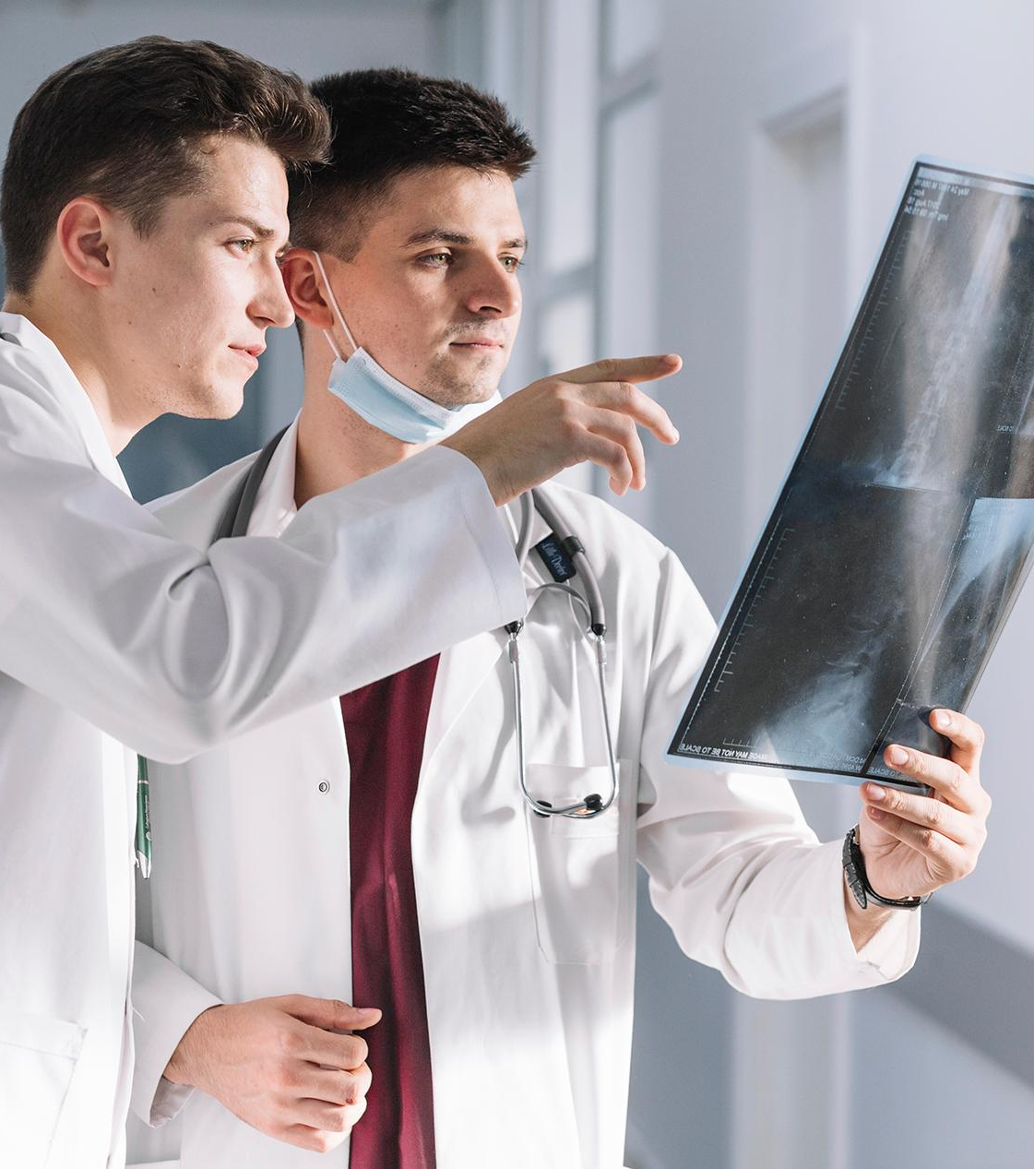
Takeaway
The CNN model developed from scratch performed better than the one that used transfer learning, demonstrating that specifically designed architectures can sometimes produce higher accuracy for particular datasets such as kidney stone CT images.
The study highlights the importance of experimenting with both custom models and transfer learning, noting that task requirements and dataset characteristics should determine the model architecture to be chosen rather than presuming that trained models will always perform better.

